Slide 1
Unit 1

Slide 2
Scripting Language
Scripting languages help in automating various software apps, web pages in a browser, shell usage of an OS (operating system), etc. The scripting languages like VBScript, Perl, Javascript, etc., do not require compilation, and they have less access to any computer’s native abilities. It is because these rather run on an original programming language’s subset. An example here could be that the Javascript won’t have the ability to access your file system.
Generally, a scripting language is interpreted. It doesn’t primarily focus on building applications- but it can render behavior to an application that already exists. It basically helps in writing codes for targeting a software system. Thus, it can also automate a given operation on any software system. So basically, scripts act as a set of instructions that target any software system.

Slide 3
The scripting languages have eventually evolved and become more powerful. They now no longer create minute scripts for automating a software system’s operations. One can also use scripting languages for building rich applications.
These can customize, manipulate, and automate an existing system’s facilities. The scripting languages come with a mechanism that exposes functionality to the program control.

Slide 4
What is a Programming Language
One needs to compile the programming languages to machine code so as to run them on the hardware of an underlying OS (operating system). A user needs to deploy a certain Integrated Development Environment (IDE) for using programming languages. A programmer needs to provide an instruction set for the computers for achieving certain goals. One can also implement certain algorithms by writing the programs.
Out of all the programming languages present in the market, specific documentation dominates a majority of them. All the other languages comprise dominant implementation (treated as a reference). An example here is that the ISO standard associates with the C programming language. On the other hand, languages like Perl belong to the latter category.

Slide 5
One can use a programming language for transforming data. It basically happens when creating those CPU instructions that jot down the input info into the output. An example here is using a set of conditions for solving an equation set. One can consider various programming languages such as C, C++, Scala, Java, etc., as general-purpose languages.
These fall under the compiled programming languages. You must add some texts to write the score code, and then you can run them through a compiler. As a result, it would create various binary instructions.

Slide 6
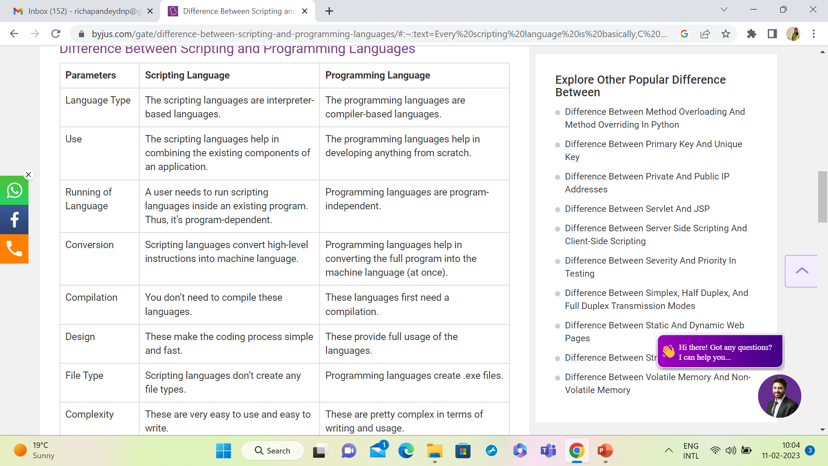

Slide 7
